Slide 1
Weekly Report
Dian Hanifudin Subhi

Slide 2
Outline
Weekly report
Summary of this week’s work
Your work
Conclusion
Your opinion/thought
Action item

Slide 3
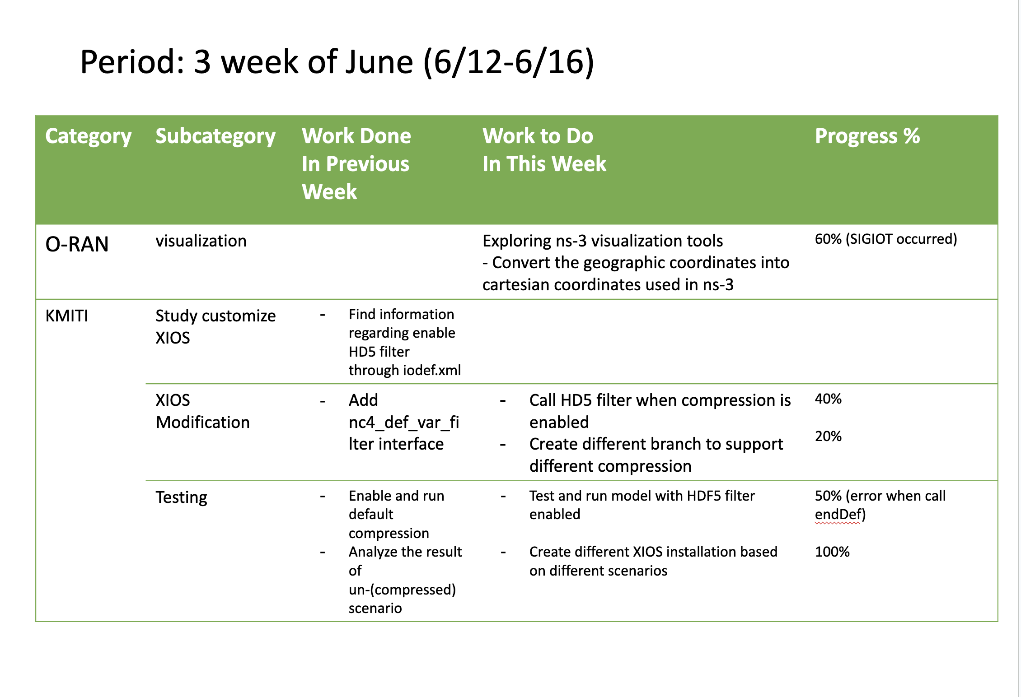
Weekly report

Slide 4
Summary of work this week
Implement SZ filter
Evaluate compressed and uncompressed scenarios

Slide 5
Question to be Answered
How is the progress of SZ filter implementation?
How to prepare the XIOS setup to support different scenarios?

Slide 6
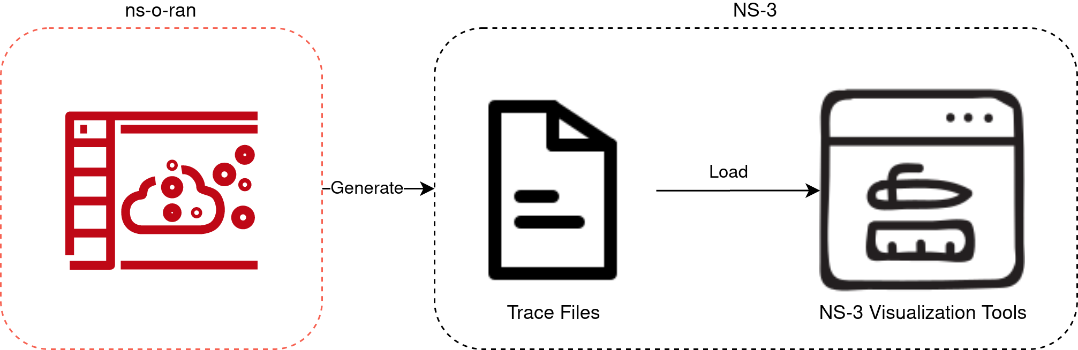
NS-3 visualization
block diagram

Slide 7
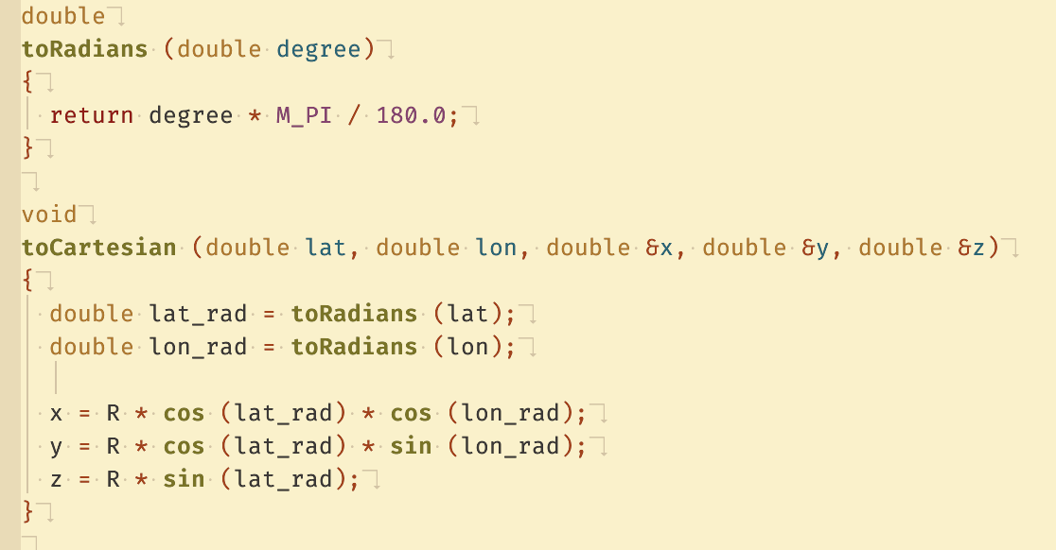
NS-3 visualization
Converting Coordinates
Add function to convert coordinates
SIGIOT occurred

Slide 8
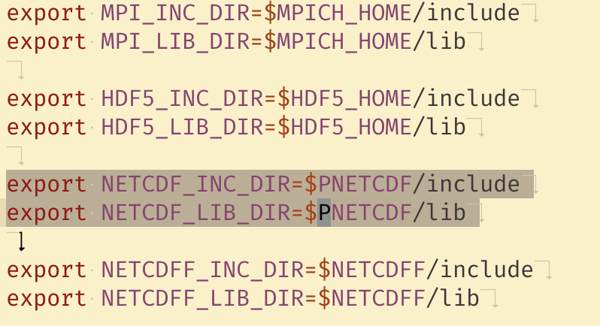
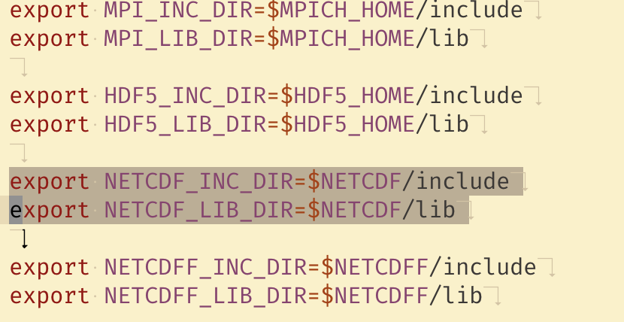
XIOS Modification
Implement SZ compression using SZ filter
Adjust the NetCDF library in XIOS

Slide 9
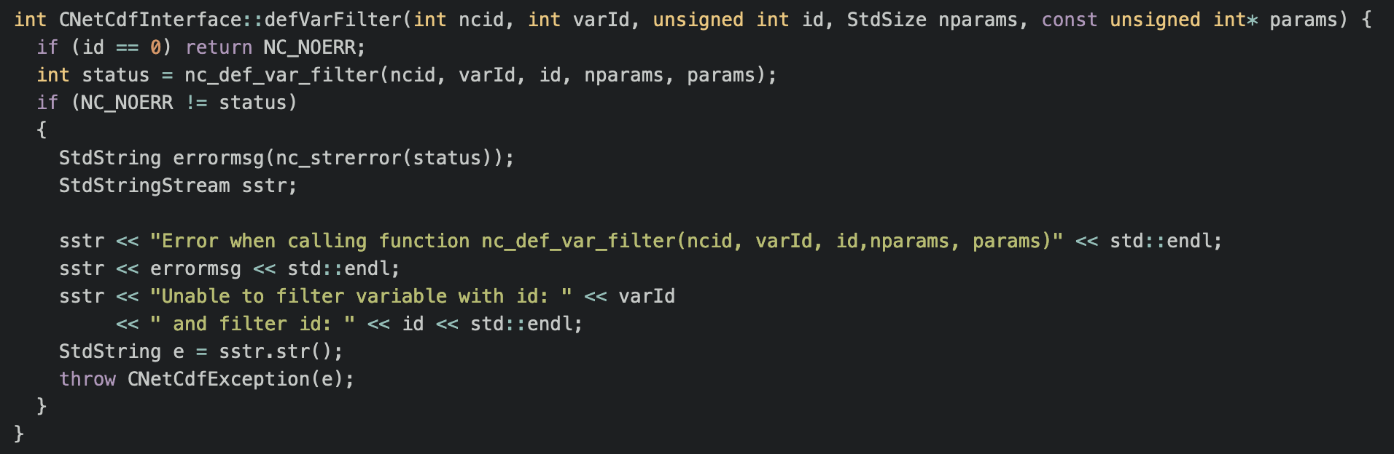
XIOS Modification
Implement SZ compression using SZ filter
Declare defVarFilter function at io/netCdfInterface.hpp
Add implementation at io/netCdfInterface.cpp

Slide 10
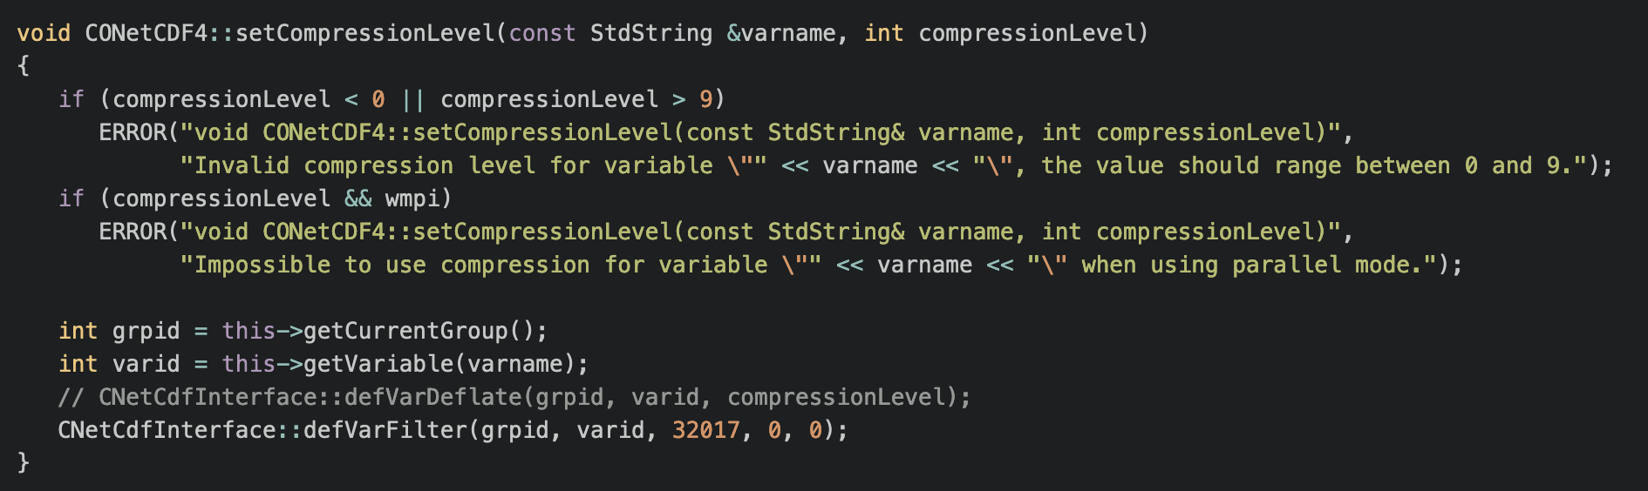
XIOS Modification
Implement SZ compression using SZ filter
Modification at io/onetcdf4.cpp

Slide 11
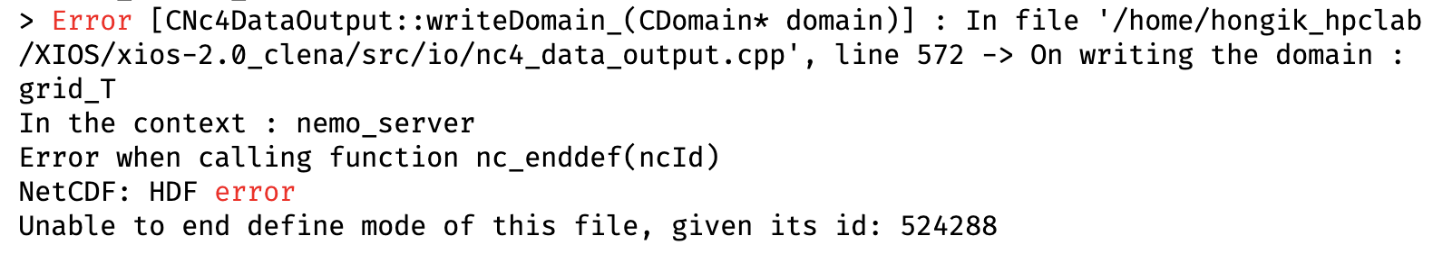
XIOS Modification
Implement SZ compression using SZ filter
Error log

Slide 12
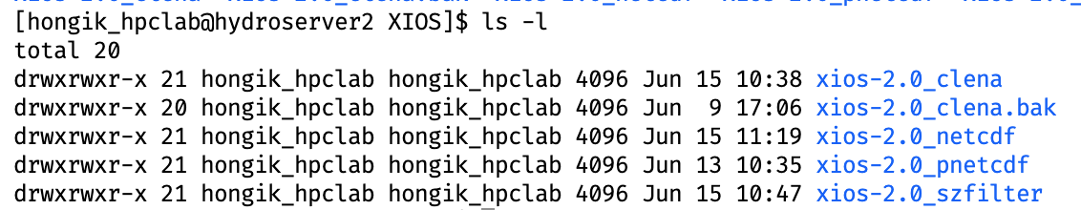
Preparing XIOS Setup
Create multiple XIOS setup
Create multiple XIOS setups based on the implemented feature, so it doesn’t need to be recompiled every time.

Slide 13
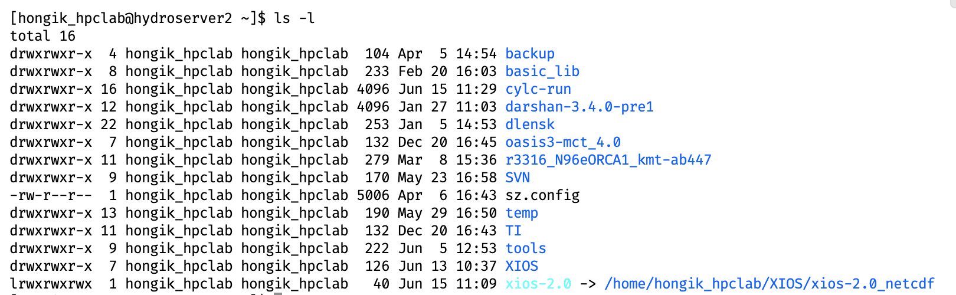
Preparing XIOS Setup
Create multiple XIOS setup
Symlink it to active feature to support active scennario

Slide 14
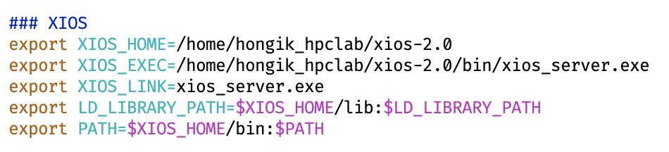
Preparing XIOS Setup
Create multiple XIOS setup
Update the ~/.bash_profile using new setup

Slide 15
Conclusion
An error occurred when applying the SZ filter, but the error was not related to the call nc filter API function. Further investigation is needed.
When switching to different scenarios, creating different XIOS per scenario can avoid the recompilation process.

Slide 16
Your opinion/thought
The error may be related to the compatibility of libraries and configuration.
Enable logging per function is needed to gather detail information of process compression flow

Slide 17
Action items
Adjust XIOS config (attach/detach) mode to ensure the error is not caused by unsupported mode
Enable logging

